Slide 1
VENTURI METER
Presented By
Dr. Diggikar J. S.
Shri Chhatrapati Shivaji College , Omerga

Slide 2
Flow measuring devices:
The measurement of fluid flow is important in
applications ranging from measurements of bloodflow
rates in human artery to the measurement of
liquid oxygen in a rocket.
 Some sort of restriction is placed in the pipe or duct
carrying the fluid. This flow restriction causes a
pressure drop that varies with the flow rate.

Slide 3
Venturi Meter:
A venturi meter is a variable head meter, which is used
for measuring the flow rate of a fluid through a pipe.
 In this meter, the fluid is gradually accelerated to a
throat and then gradually retarded in diverging section
where the flow channel expands to the pipe size.
Venturi meters have only a small head loss, no moving
parts and do not clog easily.

Slide 4
Working principle:
By reducing the cross-sectional area of the flow passage,
a pressure difference is created and the measurement of
the pressure difference enables the estimation of the
flow rate through the pipe.

Slide 5
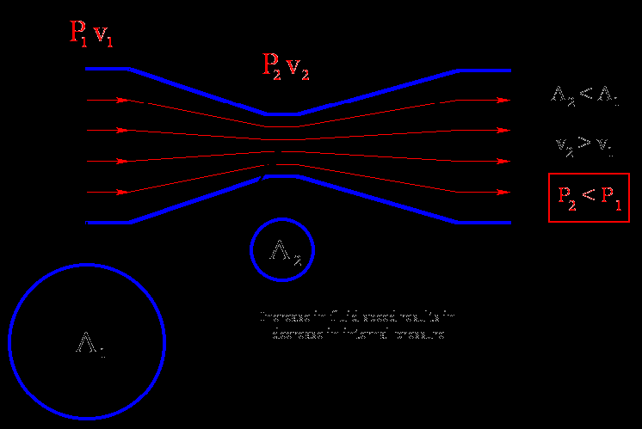

Slide 6
Construction:
A venturi meter consists of following three parts:
1. A short converging conical part
2. Throat and
3. Diverging conical part

Slide 8
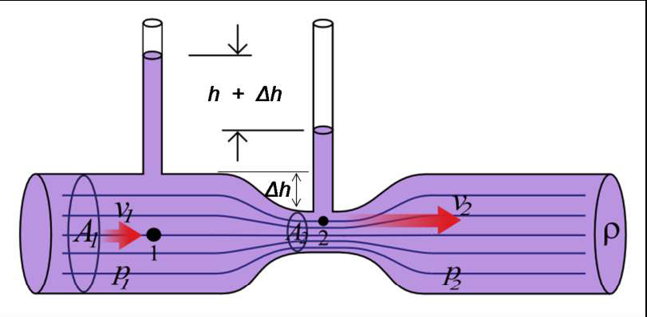

Slide 9
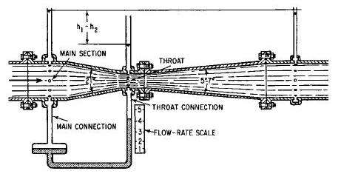

Slide 10
Coefficient of discharge:
Ratio of Actual mass or volumetric flow rate to
theoretical mass or volumetric rate .
It encompasses all the energy losses taking place
during flow through venturi meter.
 Its value depends upon the reynolds number and
ranges from 0.95 to 0.98
10

Slide 11
Applications:
1. It is used where we are working
with small pressure head.
2. Can be used for measuring flow
rates of water, gases, suspended
solids, slurries and dirty liquids.
3. Can be used to measure high flow
rates in pipes having diameters in
a few meters.
4.It doesn’t clogs easily.

Slide 12
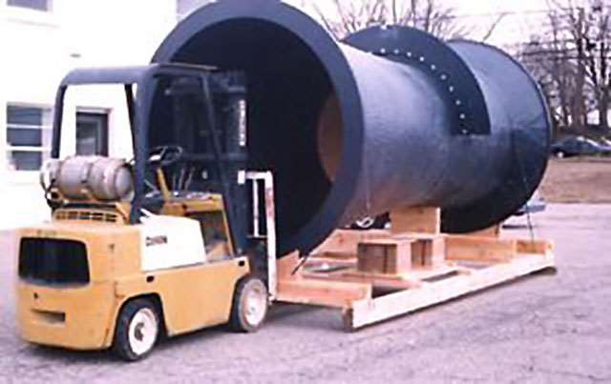

Slide 13
Limitations
They are large in size and hence where space is limited, they cannot be used.
Expensive initial cost, installation and maintenance.
Cannot be used in pipes below 7.5cm diameter.
Cannot be altered for measuring flow rate upto a wide range.

